Slide 1
An Introduction to Comet
Zhang Jian
2008-12-27

Slide 2


What is Comet?
Coined by Alex Russell in 2006
Example applications
  GMail’s GTalk integration
  Meebo

Slide 3
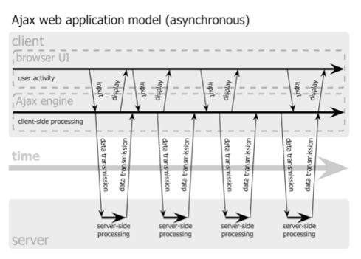
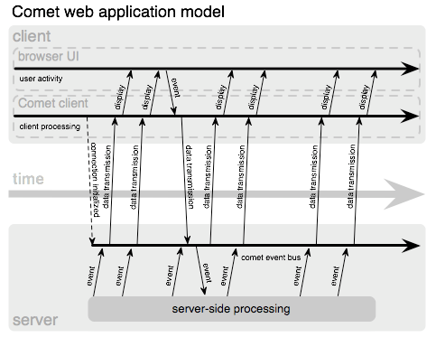
What is Comet?
Comet applications can deliver data to the client at any time, not only in response to user input.
The data is delivered over a single, previously-opened connection.

Slide 4
What is Comet?
Comet is a set of techniques providing low-latency data transit for the browser
  Interaction model
  Asynchronous
  Use native presentation technology
  Use long-lived HTTP connections
  Alternative transports

Slide 5
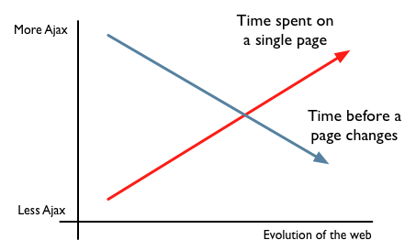
Why Is Comet Better For Users?
2 Trends
We need a simple, asynchronous, low latency way to update pages

Slide 6
Why Is Comet Better For Users?
Ajax improves single-user responsiveness
The web is inherently multi-user
Comet improves application responsiveness for collaborative, multi-user applications

Slide 7
History
1996: Push Technology was coined
  Reverse the classic Web paradigm of pulling data to the user
  PointCast was created
2000: Push Technology was finally dead
  Need install special software
  Saturate bandwidth
  No real need

Slide 8
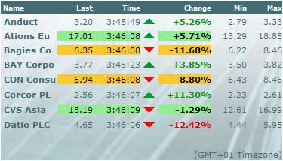
History
2000: Online security-trading systems
  A new need for real-time data being pushed to the user’s browser
  The pushed content is a series of fine-grained real-time updates to a Web page
Comet

Slide 9
History
2005: AJAX was coined
2006: Comet was coined
  New generation of Push Technology
  Actual Comet technology had existed since 2000

Slide 10
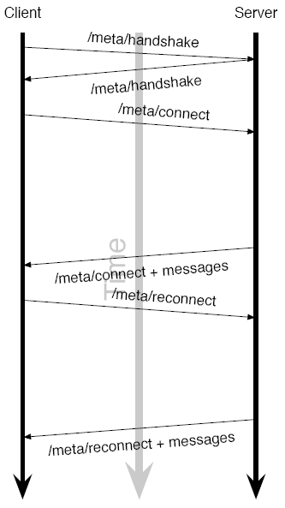
Current Comet
Existing transports
  Two categories
    Long-polling
    Streaming

Slide 11
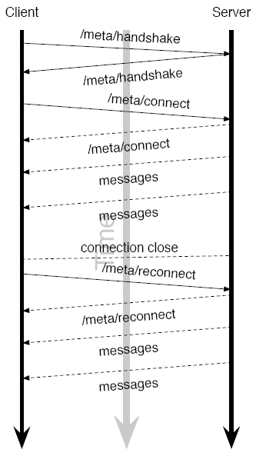
Current Comet
Existing transports
  Two categories
    Long-polling
    Streaming

Slide 12
Current Comet
Trades-offs of existing transports
  Long-polling
    Less effective
    Works in all recent browsers
  Streaming
    Ugly loading bar
    Works in all browsers released in the last 10 years

Slide 13
Current Comet
What about polling?
  Utilize the existing Ajax/XHR mechanisms
  Take very little code to implement
  Smart Polling
    Monitor user activity and employ an exponentially increasing poll time during inactivity.
setInterval(function() {
doAjax("/checkForMessages",...);
}, 20000); // poll every twenty seconds

Slide 14
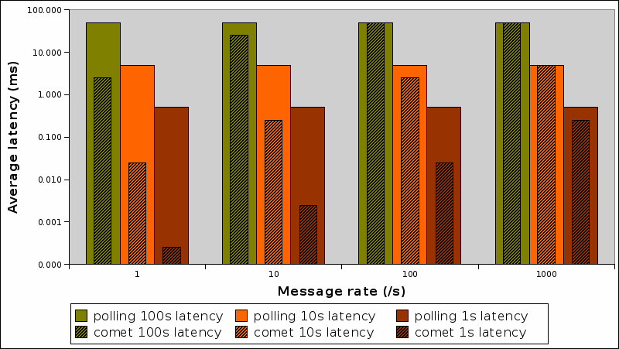
Current Comet
What about polling?
  Long-polling provides superior average latency
Notes:
Comet 1s latency + 1 message rate: 在客户端只1s延迟，几乎总是在Server端等待数据，因此数据延迟非常小
Polling 100s → 10s → 1s latency: 在客户端延迟越来越小，数据延迟减少
Comet 1000 message rate: 一到Server立马有数据，因此和Polling没啥区别

Slide 15
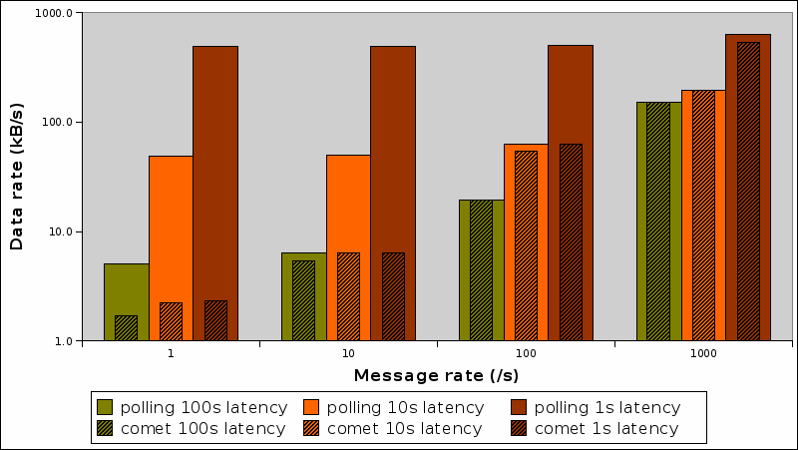
Current Comet
What about polling?
  Long-polling provides superior data rates
Notes:
Comet + 1 message rate: 大部分时间总是在Server端等待数据，因此只传输了必要的数据，数据量很小
Polling 100s → 10s → 1s latency: 在客户端延迟越来越小，往返次数增加，数据量增大
Comet 1000 message rate: 一到Server立马有数据，因此和Polling没啥区别

Slide 16
Current Comet
What about Flash and Applet?
  Rely on third-party plugin
  Blocked by firewalls

Slide 17
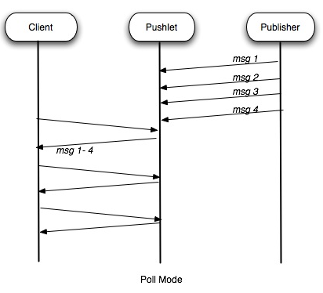
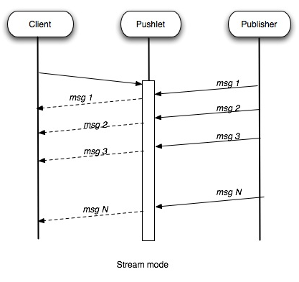
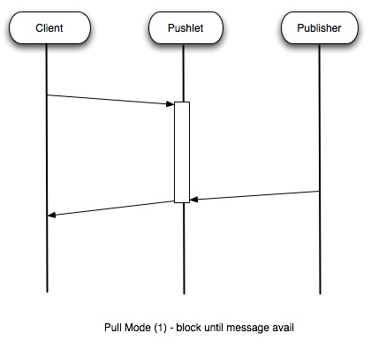
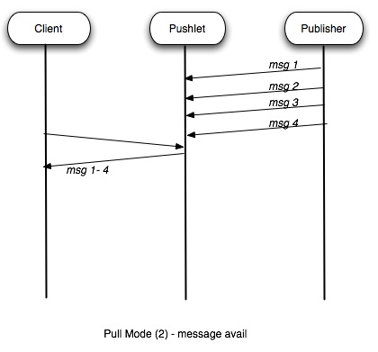
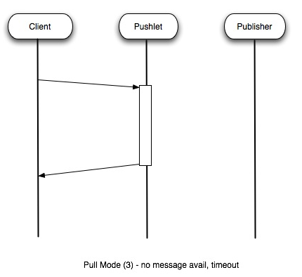
Current Comet
Example: Pushlet
  Three modes:
    Poll
    Stream
    Pull (Long-polling)

Slide 18
Current Comet
Proposed Comet protocols
  Bayeux
  HTTP Channels / REST Channels
  TCPSocket
Standardize communication between Comet servers and clients

Slide 19
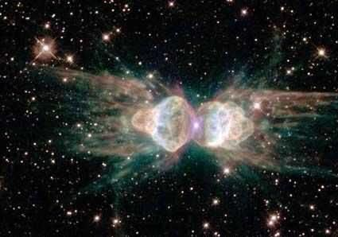
Current Comet
Proposed Comet protocols
  Bayeux
    Provide a Pub/Sub system
    Supported by a lot of comet servers
    Battle ended, Michael Carter joined other Bayeux authors

Slide 20
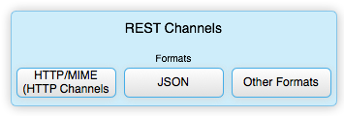
Current Comet
Proposed Comet protocols
  HTTP Channels/REST Channels
    Leverage the semantics of HTTP REST for subscribing to resources and receiving resource/data modification notifications and closely integrates with HTTP
    Supported by Persevere

Slide 21
Current Comet
Proposed Comet protocols
  TCPSocket
    TCP socket for the browser
    Use with STOMP / XMPP / IRC
    js.io: JavaScript Network Library
    Supported by Orbited

Slide 22
The Future of Comet
HTML 5
  Sever-sent events
    Define a data format for streaming events to web browsers
    An associated DOM API for accessing those events
  event-source element
    When the src is changed, the event-source closes its previous connection, and opens a new Comet connection to the new URI.

Slide 23
The Future of Comet
HTML 5
  Independence Day: WebSocket
    A full-duplex communications channel that operates over a single socket
The Holy Grail of Comet development has always been native browser support of a full-duplex, single-connection communication’s channel.

Slide 24
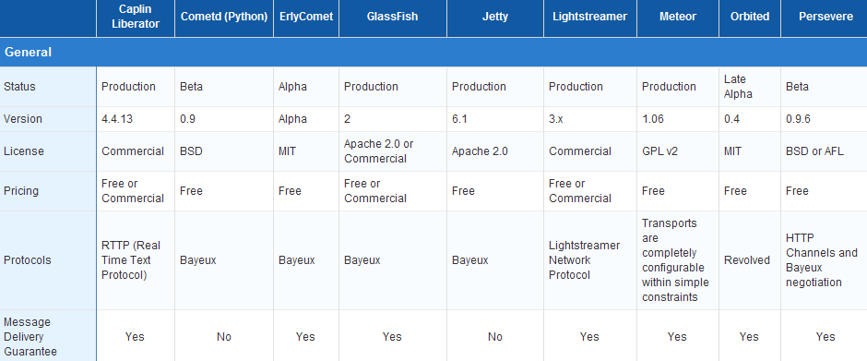
Current Comet
Available Comet Servers
  http://cometdaily.com/maturity.html

Slide 25
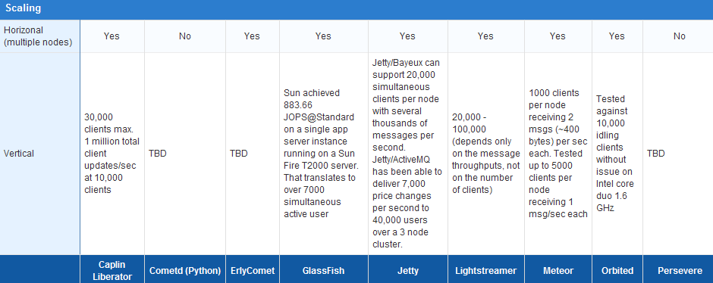
Current Comet
Does it scale?
  Event-driven IO system

Slide 26
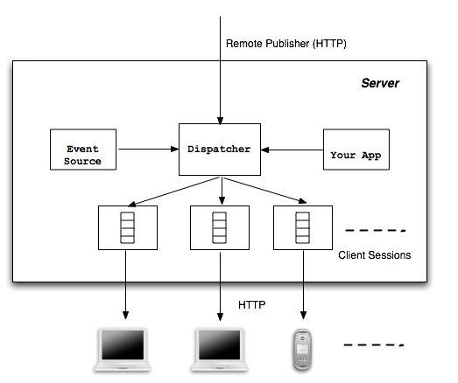
Demo
Chat by Pushlet

Slide 27
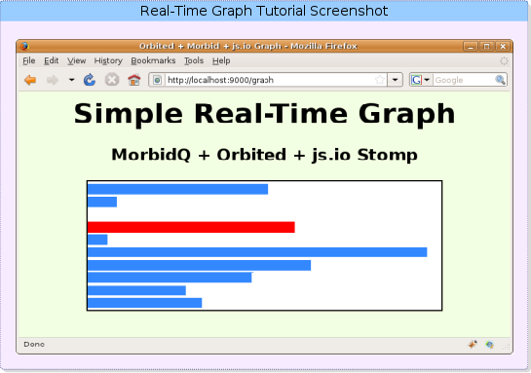
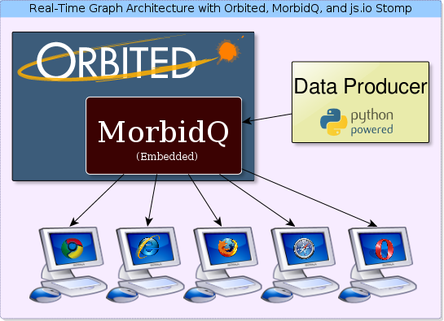
Demo
Graph by Orbited

Slide 28
References
Alex Russell, Comet: Low Latency Data for the Browser, 2006
Alessandro Alinone, Comet and Push Technology, 2007
Joe Walker, Why Comet is of Growing Importance, 2007
Jacob Rus, The Future of Comet Part 1: Comet Today, 2007
Jacob Rus, The Future of Comet Part 2: Server Sent Events, 2007
Kris Zyp, Easing into Comet, 2007
Joe Walker, Buzzword Overload, 2008
Just van den Broecke, Pushlets, 2007
Michael Carter, Independence Day: HTML5 WebSocket Liberates Comet From Hacks, 2008
Michael Carter, Scalable Real-Time Web Architecture, Part 2: A Live Graph with Orbited, MorbidQ, and js.io, 2008
周婷, Comet：基于 HTTP 长连接的“服务器推”技术, 2007

Slide 29
Q & A
Thanks

